Slide 1
RISK FACTORS OF DRUG-RESISTANT EPILEPSY IN CHILDREN WITH CEREBRAL PALSY
Stj.Dr.Elif Nur Orkan Mentor: Prof.Dr.Dilara Füsun İçağasıoğlu

Slide 2
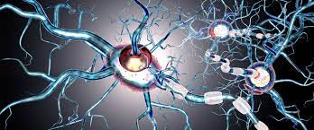
INTRODUCTION
Epilepsy is a common neurological problem in children with cerebral palsy.
Anti epileptic drugs are the basic of therapy and the majority of patients respond to this treatment. However, approximately 20-40% patients do not respond.
Resistant epilepsy is defined as the failure of adequate trials of two tolerated, appropriately chosen and administered anti-seizure drugs to achieve seizure freedom.

Slide 3
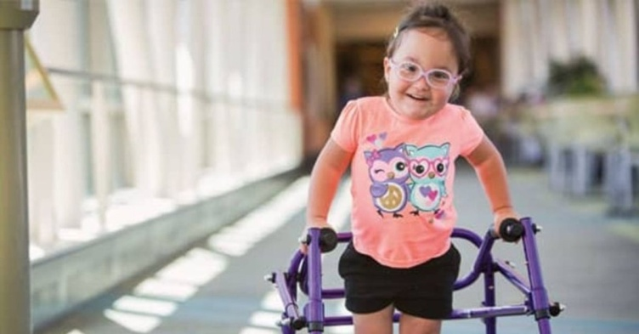
In patients with resistant epilepsy, the frequency of seizures affects negatively quality of life and cognitive function.
Identifying and preventing risk factors involved in the development of resistant epilepsy can help improve the life quality of patients in addition to the treatments applied in cerebral palsy.
The main aim of this study was to research the risk factors of drug-resistant epilepsy in children with cerebral palsy retrospectively.

Slide 4
METHODS
The study included patients aged 2-17 with a diagnosis of cerebral palsy and epilepsy.
Bezmialem Vakıf University Faculty of Medicine Hospital
Between the years of 2018-2020
The retrieved information included;
gestational age,
gestational weight,
head circumference
history of hospitalization in neonatal intensive care unit (NICU)
etiology and type of cerebral palsy
EEG activity.

Slide 5
RESULTS
Out of a total of 104 children with cerebral palsy and epilepsy, 5 individuals were excluded from the study because of the drug-free follow-up. Patients were divided into two groups;
Group 1: CP with controlled epilepsy (48,9%, n=48),
Group 2: CP with drug-resistant epilepsy (51,1%, n=46)

Slide 6
RESULTS
In our study, the difference between group 2 (drug-resistant epilepsy) and group 1 (controlled epilepsy) was statistically significant in terms of gestational week (p=0,012) and cerebral palsy type (p=0,007).
The mean age of the patients in the study group was 8(2-17) and the majority of them were male (67.4%)

Slide 7
There was increased risk of drug-resistant epilepsy in term infants (≥37 weeks) (58,7%) compared to 30-37 weeks infants (19,6%) and <30 weeks infants (21,7%) (p=0,012).

Slide 8
In drug-resistant patients with cerebral palsy, 60,9% of patients were quadriplegic, 26,1% of were diplegic, 8,7% hemiplegic, 2,2% triplegic (p=0,007).

Slide 9
No significant differences were found in sex, gestational weight, head circumference, history of hospitalization in neonatal intensive care unit, etiology of cerebral palsy and electroencephalography activity.
Our results suggested that gestational age and cerebral palsy type were risk factors for drug-resistant epilepsy.

Slide 10
REFERENCES
1. Genç F, Kutlu G, Biçer Gömceli Y, Ertuğrul İ. Ankara Eğitim ve Araştırma Hastanesi Epilepsi Bölümü’nde Düzenli Takip Edilen Dirençli Epilepsi Hastalarının Demografik ve Klinik Bulguları. Epilepsi. 2013.
2. Aggarwal HK, Jain D, Bishnoi A. Quality of Life in Patients with Drug Resistant Epilepsy. Turk J Neurol. 2019;25:159-163
3. Vural Ö , Serdaroglu A , Citak Kurt A , Hirfanoğlu T , Kurt , . Dirençli epilepsili çocuklarda ilaç dışı tedavinin etkinliği. Güncel Pediatri. 2019; 17(2): 252-243.
4. Latzer IT, Blumovich A, Sagi L, Uliel-Sibony S, Fattal-Valevski A. Prediction of drug-resistant epilepsy in children with cerebral palsy. Journal of Child Neurology 2019 Mar 1;35(3):187-194.
5. Kholin A. Cerebral palsy and epilepsy. Cerebral palsy-Clinical and Therapeutic Aspects. Al-Zwaini; 2018.
6. Gürkan F, Gökben S, Serin HM, Yılmaz S, Aktan G, Tekgül H. Determining risk factors of epilepsy in children with cerebral palsy: A retrospective study. J Pediatr Res. 2018;5(2):76-81
7. Zelnik N, Konopnicki M, Bennett-Back O, Castel-Deutsch T, Tirosh E. Risk factors for epilepsy in children with cerebral palsy. European Journal of Pediatric Neurology. 2010;14(1):67-72

Slide 11
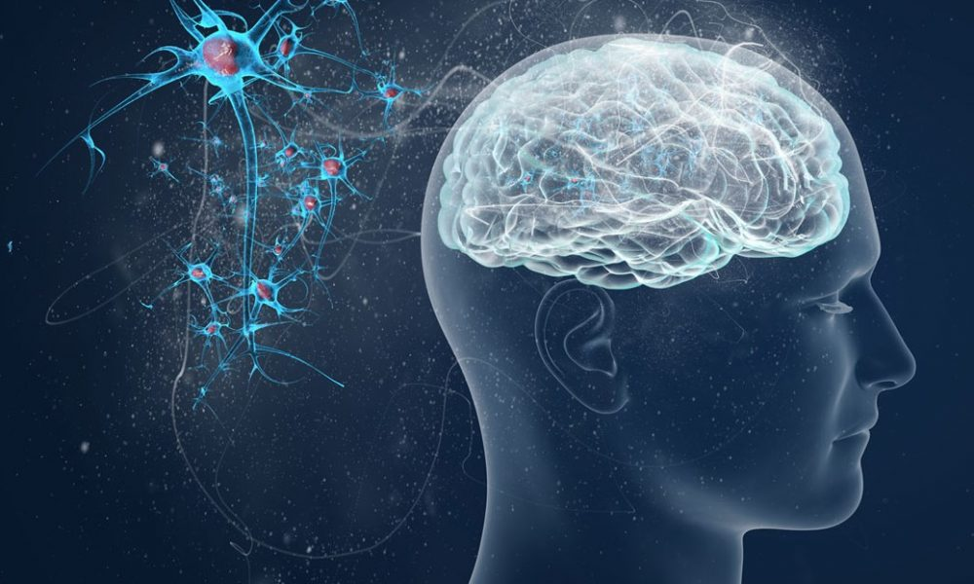
THANK YOU FOR LISTENING

